Slide 1

?????
Does Man have the God-Given Right to Name Christ’s Church?
Matthew 15:8-9
Notes:
Eddie Williams ~ April 12, 2026

Slide 2
Matthew 15:8-9 (KJV)
⁸ This people draweth nigh unto me with their mouth, and honoureth me with their lips; but their heart is far from me.
⁹ But in vain they do worship me, teaching for doctrines the commandments of men.

Slide 3
According to scriptural interpretations, Jesus Christ dictates that His church must be called by His name to be recognized as his. The Bible indicates that Christ owns, builds, and names His church, rather than delegating the naming right to humanity.

Slide 4
The Name of Christ’s Church:
Fundamental Scriptures teach the Written Word of God is Perfect
Man Must Not Add or Take Away from What is Written in the Bible
From GOD’S Mouth the Church Was Named
What Shall it be Called? The Body of Christ

Slide 5
Fundamental Scriptures Teach the Written Word of God is Perfect
II Peter 1:3 (NASB)
I Corinthians 14:37-38 (NASB)
II Timothy 2:15 (NASB)
Ephesians 3:3-4 (NASB)

Slide 6
II Peter 1:3 (NASB)
for His divine power has granted to us everything pertaining to life and godliness, through the true knowledge of Him who called us by His own glory and excellence.

Slide 7
I Corinthians 14:37-38 (NASB)
³⁷ If anyone thinks that he is a prophet or spiritual, let him recognize that the things which I write to you are the Lord's commandment. ³⁸ But if anyone does not recognize this, he is not recognized.

Slide 8
II Timothy 2:15 (NASB)
Be diligent to present yourself approved to God as a worker who does not need to be ashamed, accurately handling the word of truth.

Slide 9
Ephesians 3:3-4 (NASB)
³ that by revelation there was made known to me the mystery, as I wrote before briefly. ⁴ By referring to this, when you read you can understand my insight into the mystery of Christ,

Slide 10
Point #2: Man Must Not Add or Take Away from What is Written in the Bible
Deuteronomy 4:2 (KJV)
Proverbs 30:5-6 (KJV)
Revelation 22:18-19 (KJV)

Slide 11
Deuteronomy 4:2 (KJV)
Ye shall not add unto the word which I command you, neither shall ye diminish ought from it, that ye may keep the commandments of the Lord your God which I command you.

Slide 12
Proverbs 30:5-6 (KJV)
⁵ Every word of God is pure: he is a shield unto them that put their trust in him. ⁶ Add thou not unto his words, lest he reprove thee, and thou be found a liar.

Slide 13
Revelation 22:18-19 (KJV)
¹⁸ For I testify unto every man that heareth the words of the prophecy of this book, If any man shall add unto these things, God shall add unto him the plagues that are written in this book:

Slide 14
Revelation 22:18-19 (KJV)
¹⁹ And if any man shall take away from the words of the book of this prophecy, God shall take away his part out of the book of life, and out of the holy city, and from the things which are written in this book.

Slide 15
Point #3: From GOD’S Mouth the Church Was Named
Isaiah 62:2 (KJV)
Acts 11:26 (NASB)
Acts 4:12 (KJV)

Slide 16
Isaiah 62:2 (KJV)
And the Gentiles shall see thy righteousness, and all kings thy glory: and thou shalt be called by a new name, which the mouth of the Lord shall name.

Slide 17
Acts 11:26 (NASB)
and when he had found him, he brought him to Antioch. And for an entire year they met with the church and taught considerable numbers of people; and the disciples were first called Christians in Antioch.

Slide 18
Acts 4:12 (KJV)
Neither is there salvation in any other: for there is none other name under heaven given among men, whereby we must be saved.

Slide 19
Point #4: What Shall it be Called? The Body of Christ
Romans 16:16 (KJV)
Colossians 1:18 (KJV)
Colossians 1:24 (KJV)
Ephesians 1:22-23 (NASB)
I Corinthians 12:27 (KJV)
I Corinthians 12:12-13 (KJV)

Slide 20
Romans 16:16 (KJV)
Salute one another with an holy kiss. The churches of Christ salute you.

Slide 21
Colossians 1:18 (KJV)
And he is the head of the body, the church: who is the beginning, the firstborn from the dead; that in all things he might have the preeminence.

Slide 22
Colossians 1:24 (KJV)
Who now rejoice in my sufferings for you, and fill up that which is behind of the afflictions of Christ in my flesh for his body's sake, which is the church:

Slide 23
Ephesians 1:22-23 (NASB)
And He put all things in subjection under His feet, and made Him head over all things to the church, which is His body, the fullness of Him who fills all in all.

Slide 24
I Corinthians 12:27 (KJV)
Now ye are
the body of Christ,
and members in particular.

Slide 25
I Corinthians 12:12-13 (KJV)
¹² For as the body is one, and hath many members, and all the members of that one body, being many, are one body: so also is Christ.

Slide 26
I Corinthians 12:12-13 (KJV)
¹³ For by one Spirit are we all baptized into one body, whether we be Jews or Gentiles, whether we be bond or free; and have been all made to drink into one Spirit.

Slide 27
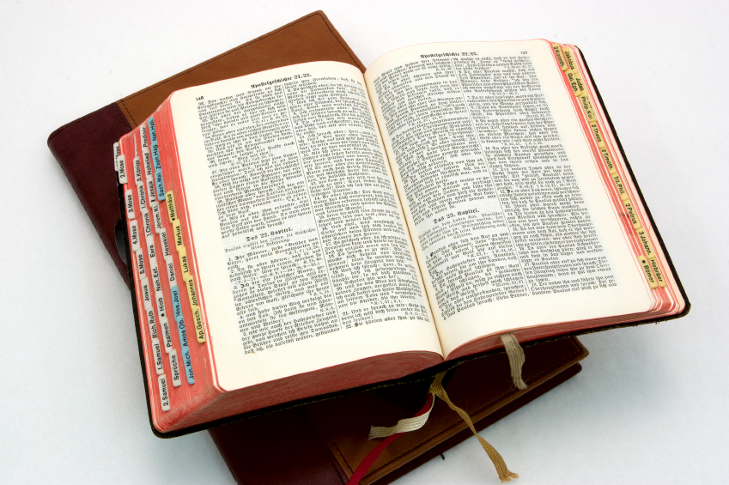
Hear: Romans 10:17
So then faith cometh by hearing, and hearing by the word of God.

Slide 28
Believe: Hebrews 11:6
But without faith it is impossible to please him: for he that cometh to God must believe that he is, and that he is a rewarder of them that diligently seek him.

Slide 29
Repent: Luke 13:3
I tell you, Nay: but, except ye repent, ye shall all likewise perish.

Slide 30
Confess: Matthew 10:32-33
32 Whosoever therefore shall confess me before men, him will I confess also before my Father which is in heaven.
33 But whosoever shall deny me before men, him will I also deny before my Father which is in heaven.

Slide 31
Baptize: Acts 22:16
And now why tarriest thou? arise, and be baptized, and wash away thy sins, calling on the name of the Lord.

